Slide 1
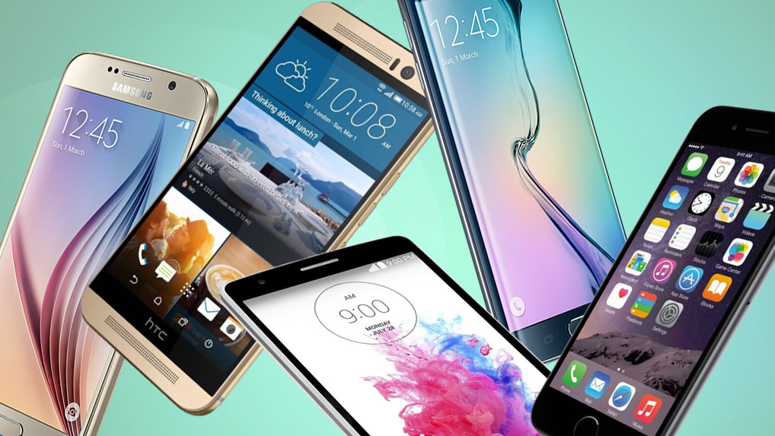
Smart phone price prediction
Xudong Li

Slide 2
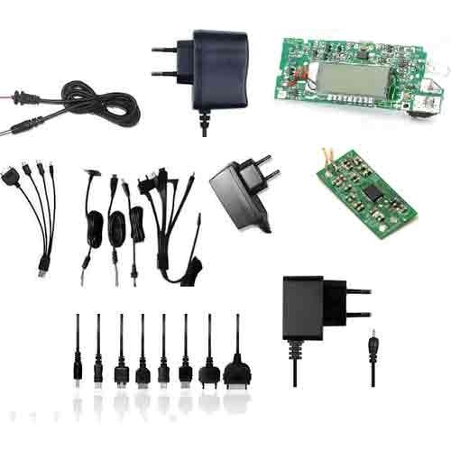

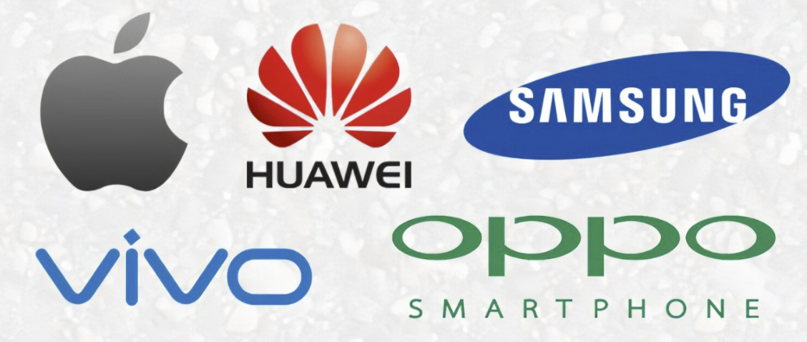
Who might care?
Mobile parts manufacturer
Smart phone users
Smart phone companies

Slide 3
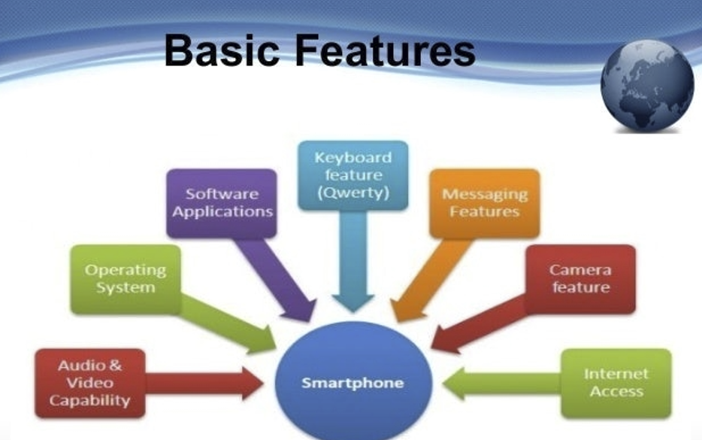
What parameters might affect price?

Slide 4
Data information
Provide by : Kaggle
Last updated day : 2021-04-25
Data columns : 20 parameters
Data rows : 459 rows
Operation system only Android

Slide 5
Data cleaning
Step 1: cleaning all unnecessary symbols
Step 2: Recreate the value containing the operation into a new column
Step 3: separate numerical variables and categorical variables

Slide 6
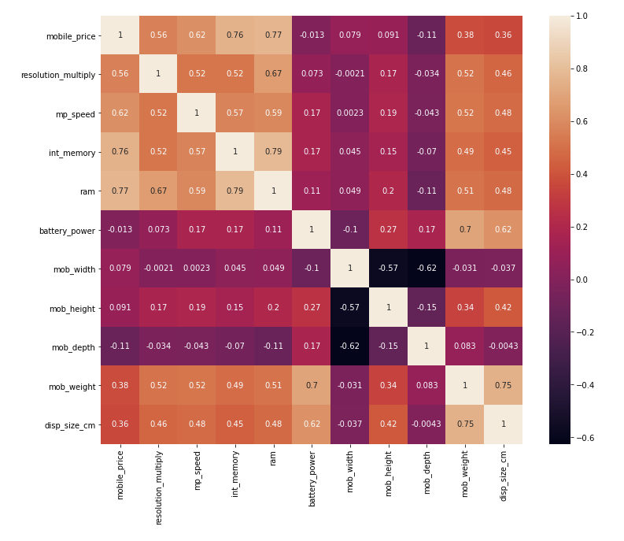
Data exploration
Ram : 0.77
Int_memory: 0.76
Mp_speed: 0.62
Resolution_multiply: 0.56

Slide 7
Training the data with different model
Linear Regression Ridge Regression
k Neighbors Regression SVM (support vector machine)
Lasso Regression Gradient Boosting
Random Forest Regression

Slide 8
Modeling overview
Type：Supervised learning
Problem type：Regression problem
Testing/Training: 25% / 75%
Tools: Python

Slide 9
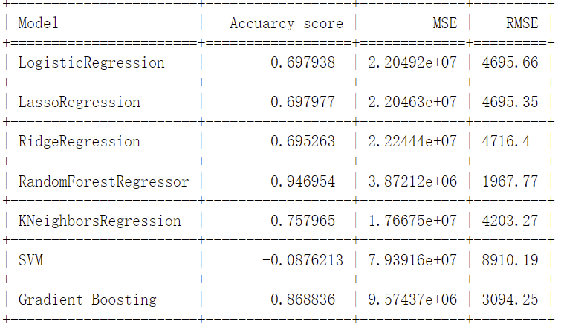
Model result summary

Slide 10
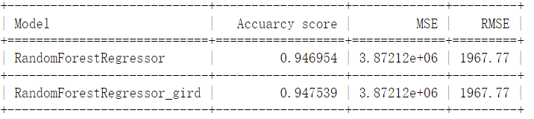
Model result with grid search method

Slide 11
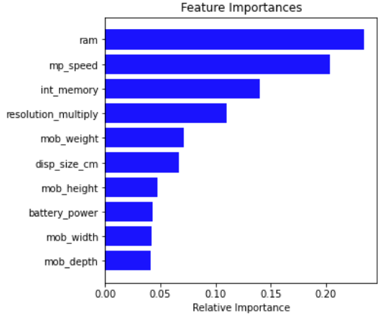
Features importance

Slide 12
Future Improvements
The operating system of all mobile phones in this project is Android. For iPhone, the world's largest phone brand, it could have turned out differently.
In the future, comparing the importance of the same parameter under different operating systems may be a topic.

Slide 13
Thank you !
Xudong Li
E-mail: lv16462873259@gmail.com
Project report link: https://github.com/Xudong1994/Unit-20/blob/b8f14a58b95e9fbe80486eae9b17633e2c5f1f0c/Capstone%20two%20project%20report.pdf

